Slide 1
Junior Stockman’s Club Beef Breed I.D.
Gary D. Fike
County Extension Director

Slide 2
First Exercise: English Breeds of beef cattle – Bos taurus
Hereford
Brought to U.S. from England in 1843 to Kentucky for statesman Henry Clay’s Kentucky farm.
Red with white face, underline/belly, white tail switch.
2nd largest breed registry in U.S.
Docile breed
Noted for hardiness in all weather zones and efficiency of converting feed to gain

Slide 3
English Breeds of Beef Cattle
Red Angus
Same cattle genetically, as Angus, but different hide color and have their own breed association (Commerce City, Colorado).
Fourth largest breed registry in the U.S.
Solid red in color.
Known for docility, quality of beef, and maternal traits (calving ease, milk, etc.)

Slide 4
English Breeds of Beef Cattle
Angus
Largest beef breed in the U.S. in terms of registration numbers. Headquarters in St. Joseph, MO.
Solid black, polled (no horns)
Came from Scotland to the US (Victoria, Kansas) in 1873; imported by George Grant.
Known for meat quality and maternal traits.

Slide 5
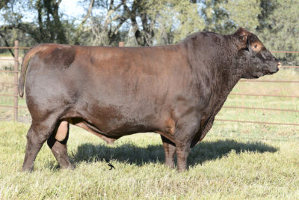
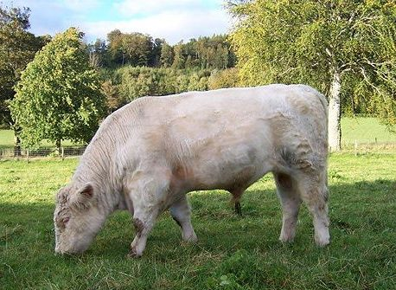
English Breeds of Beef Cattle
Shorthorn
May be red, white, or roan (mixture of red and white hairs).
Minor breed in the U.S.
Came from England in 1783 to Virginia; known as “Durham” or “Durham Reds” for a period of time.
Headquarters in Kansas City, MO.
Known for high quality meat and milking ability (a line of milking Shorthorns exists in the dairy industry).

Slide 6
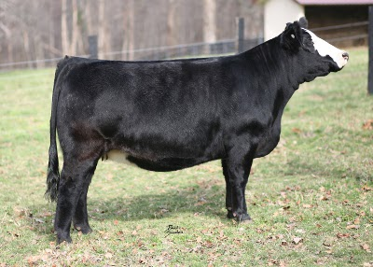
Continental Breeds of Beef Cattle
Simmental (pronounced Simm-en-tall)
Originated from Switzerland. Semen imported into the US in 1971. Third largest breed registry in the US. Headquarters in Bozeman, Montana.
Large framed, heavy boned, heavy muscled cattle; used for both meat and milk in Europe.
Cattle originally yellowish to red with white markings. Simm-Angus may be either mostly black or red.
Twinning is more common in Simmentals than other breeds.

Slide 7
Continental Breeds of Beef Cattle
Charolais (pronounced SHAR-lay)
From France. Imported to the US in 1934 via Mexico.
All white in color, the breed is noted for being heavy muscled, lean, growthy, and heavy boned.
Limited marbling for beef quality unless crossbred with English breeds.
Fifth largest breed registry in the US.

Slide 8
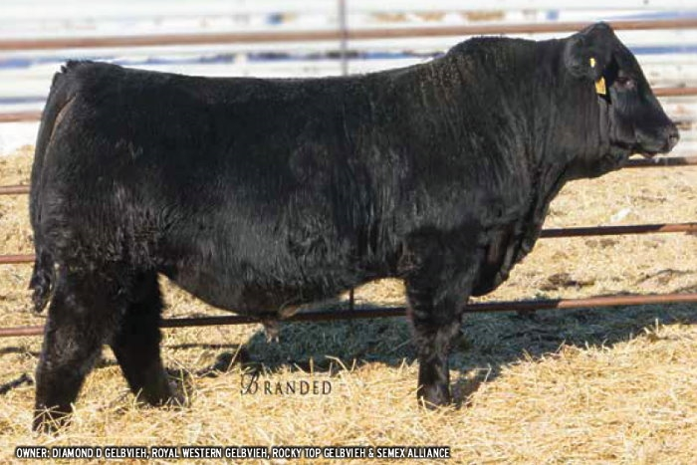
Continental Breeds of Beef Cattle
Gelbvieh (pronounced GELP-fee)
From Germany, imported to the US in
Heavy muscled, lean cattle, originally solid, yellowish-red in color. “Balancers” are a composite between Angus/Red Angus and Gelbvieh.
Females in this breed known for reaching puberty very early in life, at 5-6 months sometimes.

Slide 9
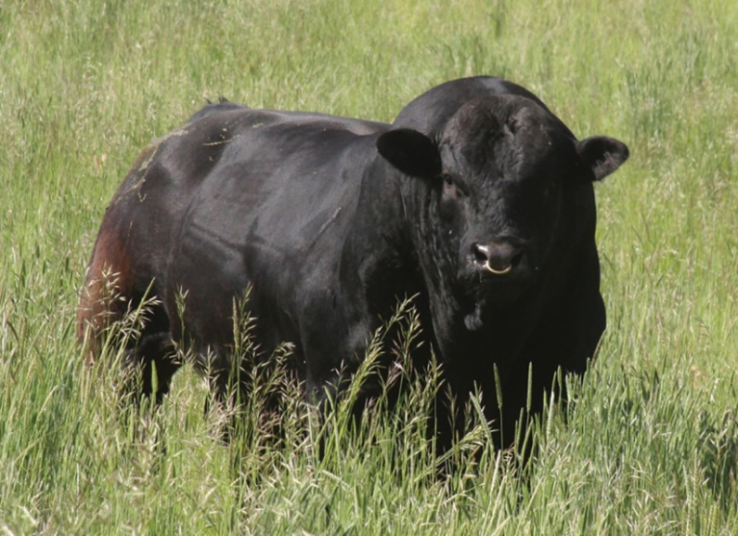
Continental Breeds of Beef Cattle
Limousin (pronounced like a limousine you drive!)
Originally from France, came to US in
Solid red in color; wide muzzle
VERY heavy muscled cattle
Crossed with Angus, known as Lim-Flex
Meat is lean, not much marbling

Slide 10
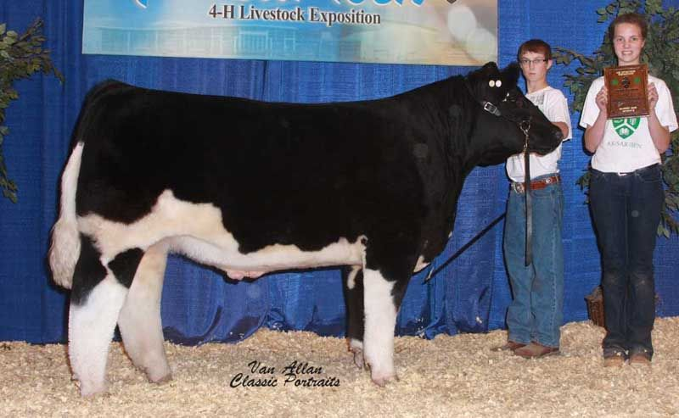
Continental Breeds of Beef Cattle
Maine-Anjou (MANE- anjoo)
From France, red and white spotted cattle
Definitely have one of the more desirable phenotypes, but commercially are not widely used in the commercial beef industry

Slide 11
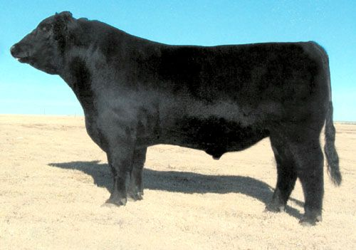
Continental Breeds of Beef Cattle
Chianina – pronounced KEY-uh-NEEN-uh
From Italy
HUGE frame scores on the purebreds, which are white to gray in color.
Crossed with Angus to be known as ChiAngus; many more of these exist than the gray-colored cattle in the US
Minor breed, commercially; big in the show ring

Slide 12
Continental Breeds of Cattle
Salers (pronounced SAY-leer)
Originally this breed is from France
Imported to US in 1972
Noted for easy calving and mothering ability
May also be black, but they were originally dark red in color

Slide 13
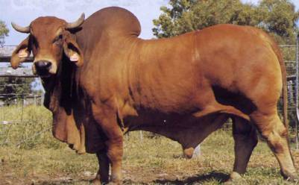
Beef Breeds – other – Bos indicus
Brahman
Gray/silver with darker points, may also be red
Originated from Zebu cattle from India to become the American Brahman
Loose hide, insect, disease and heat-resistant; utilized in hot climates along the Gulf coast in the US

Slide 14
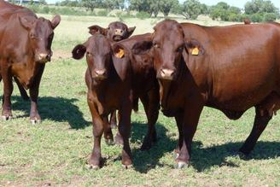
Beef Breeds – other – Bos indicus x Bos taurus
Santa Gertrudis
Developed by the King Ranch, Kingsville, TX
3/8ths Brahman x 5/8ths Shorthorn
With Brahman influence, gets heat, insect and disease resistance; this breed primarily found in the southern US
Breed recognized by USDA in 1940 and breed association founded in 1951
Considered a minor breed with fewer than 5,000 head registered

Slide 15
Beef Breeds – Other – Box indicus x Bos Taurus
Brangus
5/8^{ths} Angus; 3/8ths Brahman
Angus breeding offers more carcass quality; Brahman added longevity and parasite resistance
Brangus cattle were developed and breed association formed in the US in 1949. Headquarters is in San Antonio, TX

Slide 16
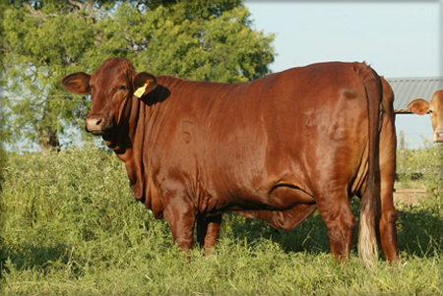
Beef Breeds – other – Bos indicus x Bos taurus
Beefmaster
Composite breed made of up of ½ Brahman, ¼ Hereford, and ¼ Shorthorn cattle.
Developed by the Lasater Ranch in Texas in early 1900’s by crossing Brahman bulls on Hereford x Shorthorn cows
Milk, conformation, carcass and disposition all stressed in selection
Cattle survive well in the southern US

Slide 17
Beef Breeds - other
Wagyu – (pronounced Why-goo)
Origin – Japan
Very high marbling, high quality beef
Finer boned and lighter muscled than most beef breeds; slow growth rate
The beef from Wagyu cattle is served in finer restaurants and is often very highly priced.
Have been crossbred with other beef breeds to add muscle and bone

Slide 18
Beef Breeds - other
Texas Longhorn
Derived from escaped cattle from Spanish explorers. First cattle driven north from Texas to Kansas railheads
Noted for easy calving
Noted for horn span
Color is predominantly red and white spotted or patches of color; some may be black

